Slide 1
Unit 3 Simplify and Reduce
Algebra 1

Slide 2
Simplifying Rational Expressions
Completely Factor the Numerator and Denominator
Check for a GCF
If a Binomial, Check for a Difference of Two Squares
If a Trinomial, Check for Factors of C that Combing to B
Cancel All Matching Terms

Slide 3
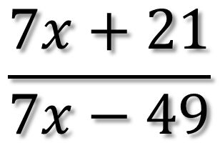
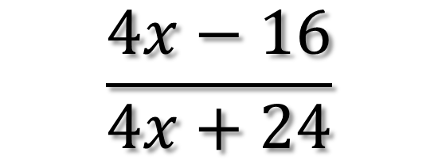
Simplifying Polynomials
$$\frac{4x−16}{4x+24}$$
$$\frac{7x+21}{7x−49}$$

Slide 4
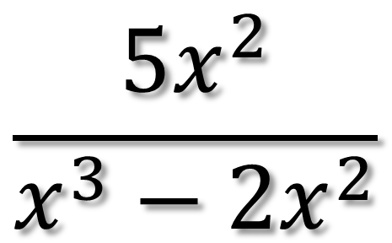
Simplifying Polynomials
$$\frac{{5x}^{2}}{x^{3}−{2x}^{2}}$$

Slide 5
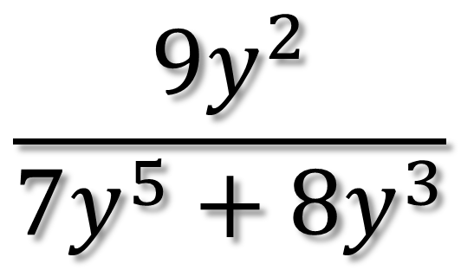
Simplifying Polynomials
$$\frac{{9y}^{2}}{{7y}^{5}+{8y}^{3}}$$

Slide 6
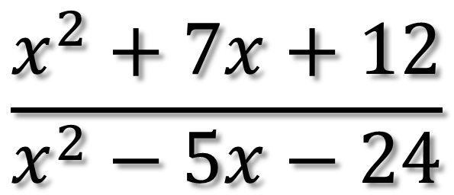
Simplifying Polynomials
$$\frac{x^{2}+7x+12}{x^{2}−5x−24}$$

Slide 7
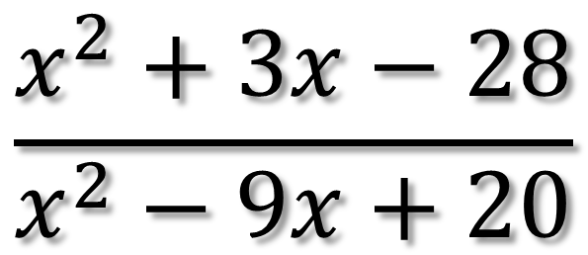
Simplifying Polynomials
$$\frac{x^{2}+3x−28}{x^{2}−9x+20}$$

Slide 8
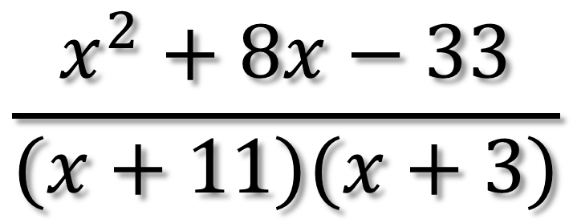
Simplifying Polynomials
$$\frac{x^{2}+8x−33}{(x+11)(x+3)}$$

Slide 9
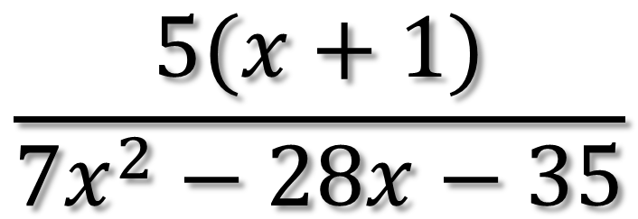
Simplifying Polynomials
$$\frac{5(x+1)}{{7x}^{2}−28x−35}$$

Slide 10
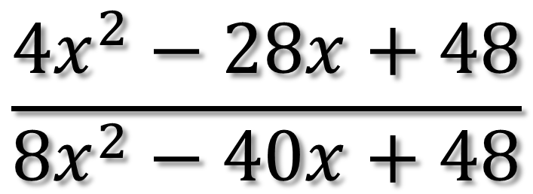
Simplifying Polynomials
$$\frac{{4x}^{2}−28x+48}{{8x}^{2}−40x+48}$$

Slide 11
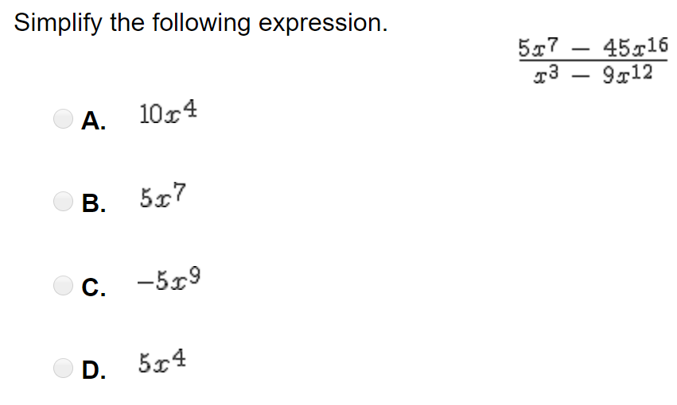
Simplifying Polynomials

Slide 12
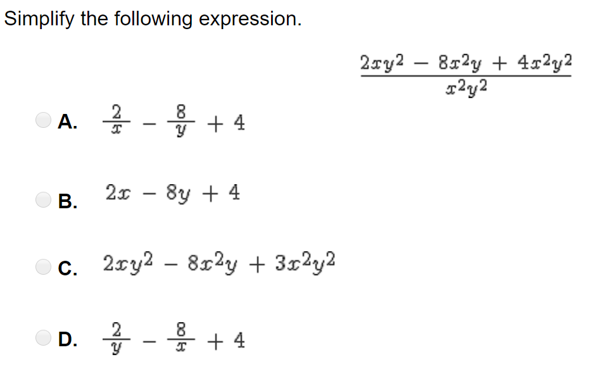
Simplifying Polynomials

